Slide 1

Business apps we love for small business owners
Presented By Zachary Dean

Slide 2



Agenda
Overview
Intro to APPS
Review, Q&As

Slide 3
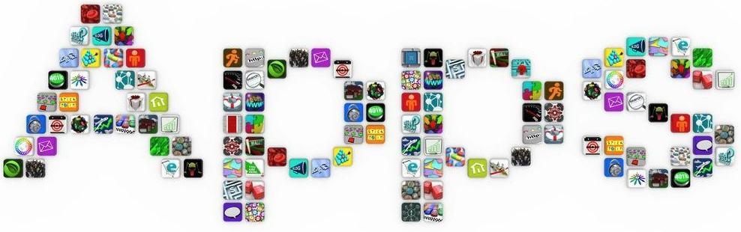
Overview
Whether they’re saving you time, increasing your productivity, or making you more secure, installing amazing new business apps is the workplace equivalent of opening presents on Christmas day. Those “How did we manage before?” moments give everyone a lift, and mark another step forward in the evolution of your business.
There are lots of fantastic business apps around that could help. Here are a few that we think could make a big difference to small businesses everywhere.

Slide 4

Salesforce
Salesforce – the easy way to manage your sales leads
CRM (Customer Relationship Management) systems can be complex and confusing for everyone except the guy who installed it. However, tracking all your customer prospects, leads, and existing customers is crucial to keep those sales coming in. Salesforce is the king of CRM and sales pipeline tools, and although it’s seen by many as an enterprise level solution, it has a range of plans to suit different budgets and needs.
The basic package comes with the lead tracking essentials. You can then upgrade for extra data capabilities and campaign management, or go for the premium package for deep integration and customization.
It’s functionality makes it the leading CRM tool for small businesses globally,
and it has the options you’ll need as your business grows.

Slide 5

Constant Contact
Constant Contact – Manage Your email marketing, anywhere you are
The Constant Contact List Builder App - Sign up new subscribers right on your tablet using the free List Builder app. You can instantly add contacts to any list, create new lists, and even add contacts offline.
Constant Contact makes it easy for you to succeed. Connect with your customers and prospects in minutes with email marketing. With so many great features, including one-click editing, social integration, and comprehensive tracking, see for yourself how powerful email marketing can be.
The industry’s #1 email marketing tool

Slide 6
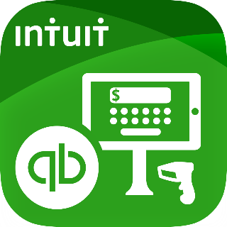
Quick Books
Intuit Quickbooks – simple, straightforward accounting
Managing your financial accounts and keeping your books up to date is vital for making informed business decisions. If you struggle to keep track there are lots of different tools around to help, but even if you have a dedicated accounts team, Intuit Quickbooks could make the whole process easier and more efficient.
Quickbooks gives you a real-time view of your financial accounts so you can make up to the minute decisions. It simplifies expenses and invoice tracking, helps you calculate tax and can be used to run your payroll. Bringing together essential features at reasonable costs, this easy to use business app will save you heaps of time, and probably a few headaches too.

Slide 7

Last Pass
LastPass – keep all your passwords in one place
We use more online programs and services than ever before. They make our lives easier, simplify business processes, and improve productivity. Until you forget your password — then you’re stuck.
If you’re tired of resetting forgotten passwords then LastPass is an essential. It stores all your passwords in one place, so you only have to remember one. LastPass will log you straight into sites in just one click, and let you share passwords simply and securely across teams.
It will even add to your online security by creating complex passwords for you, so you don’t have ‘childsfirstname86’ as the password on all your accounts.

Slide 8

Slack
Slack – the messaging app to save you from your inbox
Ever had days where all you do is look through, read and send emails? If your inbox is an exasperating drain on your time, then Slack could be the answer to your prayers.
Slack is an internal messaging app that lets teams, departments and whole businesses speak to each other easily. As well as direct messages, you can set up channels for specific topics (industry news, customer feedback) to keep everyone informed. Then if you start a new project, you can create a channel for the people involved.
The big difference is being able to easily navigate to the conversation you want, rather than digging through old emails. You can also share files and images, and set up channels with suppliers or partners if they have it too. There’s a whole host of useful plugins as well — for example you can set up a report to pull in performance data every week so it’s shared with your team automatically.

Slide 9

Wunderlist
Wunderlist – organize your life
Are you a list maker? Do you get kicks from crossing out completed tasks? Or do you just keep everything upstairs and back yourself to remember? Either way, Wunderlist could help you.
Wunderlist helps you track all your tasks on its straightforward interface. It has features you would expect like setting reminders and making notes, but also lets you share items with friends or co-workers and allows them comment, so you can see any feedback right there in your workflow. And it syncs across all your devices so you never miss a task again.

Slide 10

Stride Drive
Stride Drive – Mileage Tracker, Expense Log, & Taxes
This free app runs in the background, quietly logging every mile you drive, and then it generates an IRS-ready report that you can use to do your taxes.
Stride Drive also tracks expenses like car washes, parking fees, tolls, etc. If you’re not sure what expenses are trackable, the app will walk you through the steps to figure it out.
Stride Drive is available on iOS and Android – and did we mention it’s free?

Slide 11
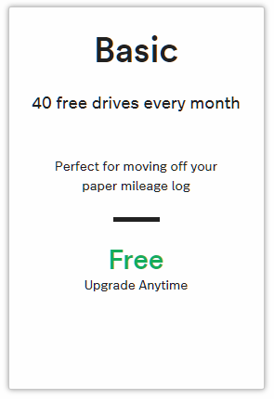
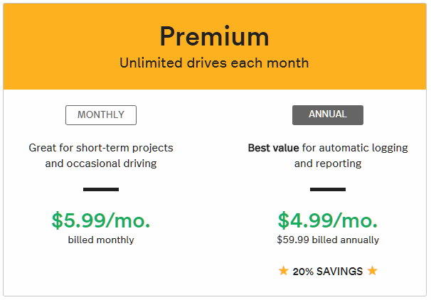

MileIQ
MileIQ – the leading Mileage Tracking app for Android and iPhone. Ditch your mileage tracker forms and let us handle your business miles for taxes.
Automatic Tracking - MileIQ catches your drives automatically. The app runs in the background tracking your miles and creating a comprehensive record of your drives.
Classify Drives With Ease - Swipe right for business drives – swipe left for personal drives. Easily add details such as parking, tolls or drive purposes to suit your specific needs
Accurate Reports - MileIQ creates a record of your mileage and sends you weekly reports. Need more? Use the web dashboard to generate highly customizable reports.

Slide 12
Summarize
Review…
Questions & Answers
Zachary Dean
At Your Service Technologies
Client Relations Manager
585-645-6213
zachary@aysroc.com

