Slide 1
Work-Life Balance:
What Makes it Possible
Chris Pollock
cwpollock@gmail.com
www.linkedin.com/in/chrispollock/

Slide 2

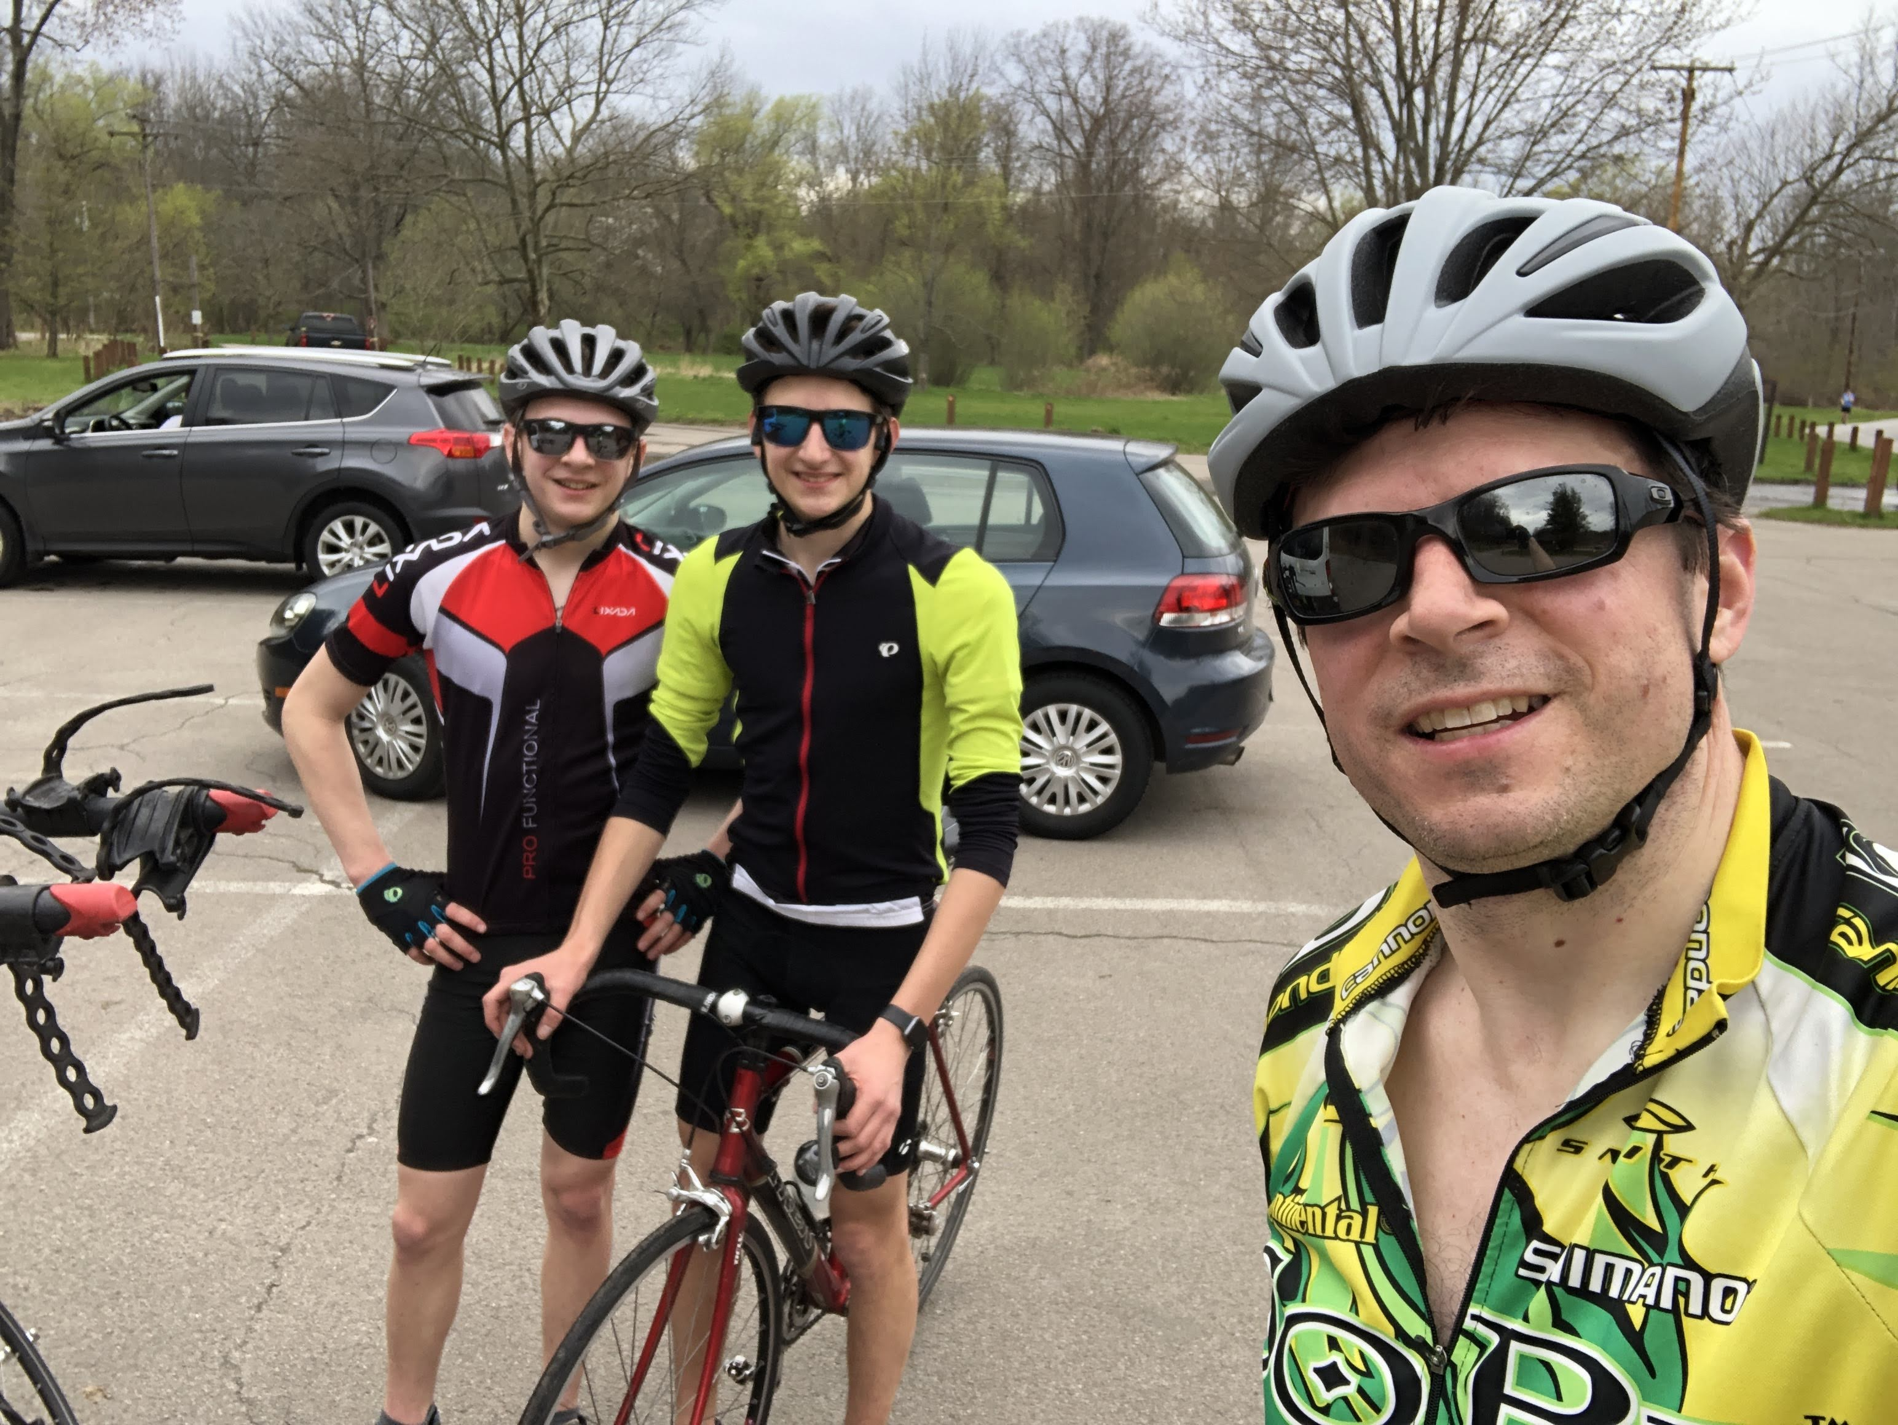
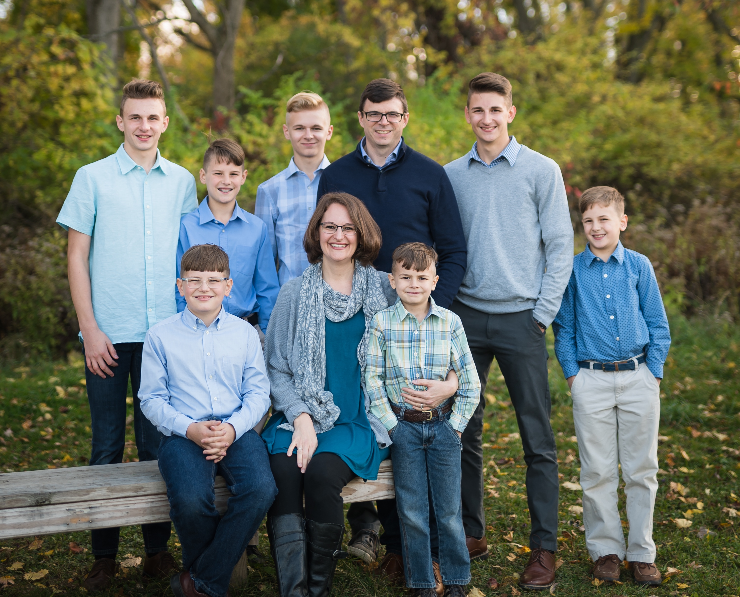


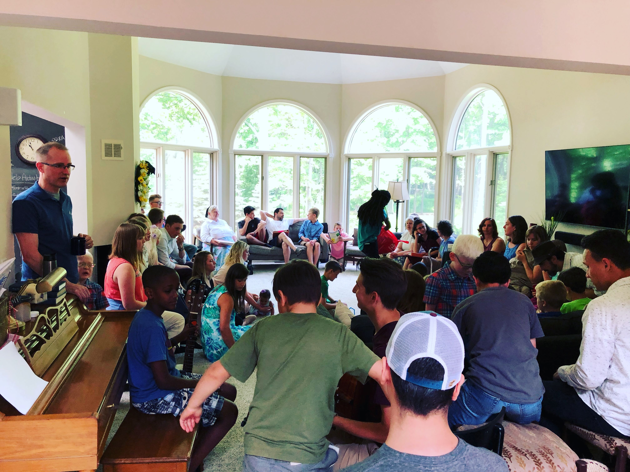
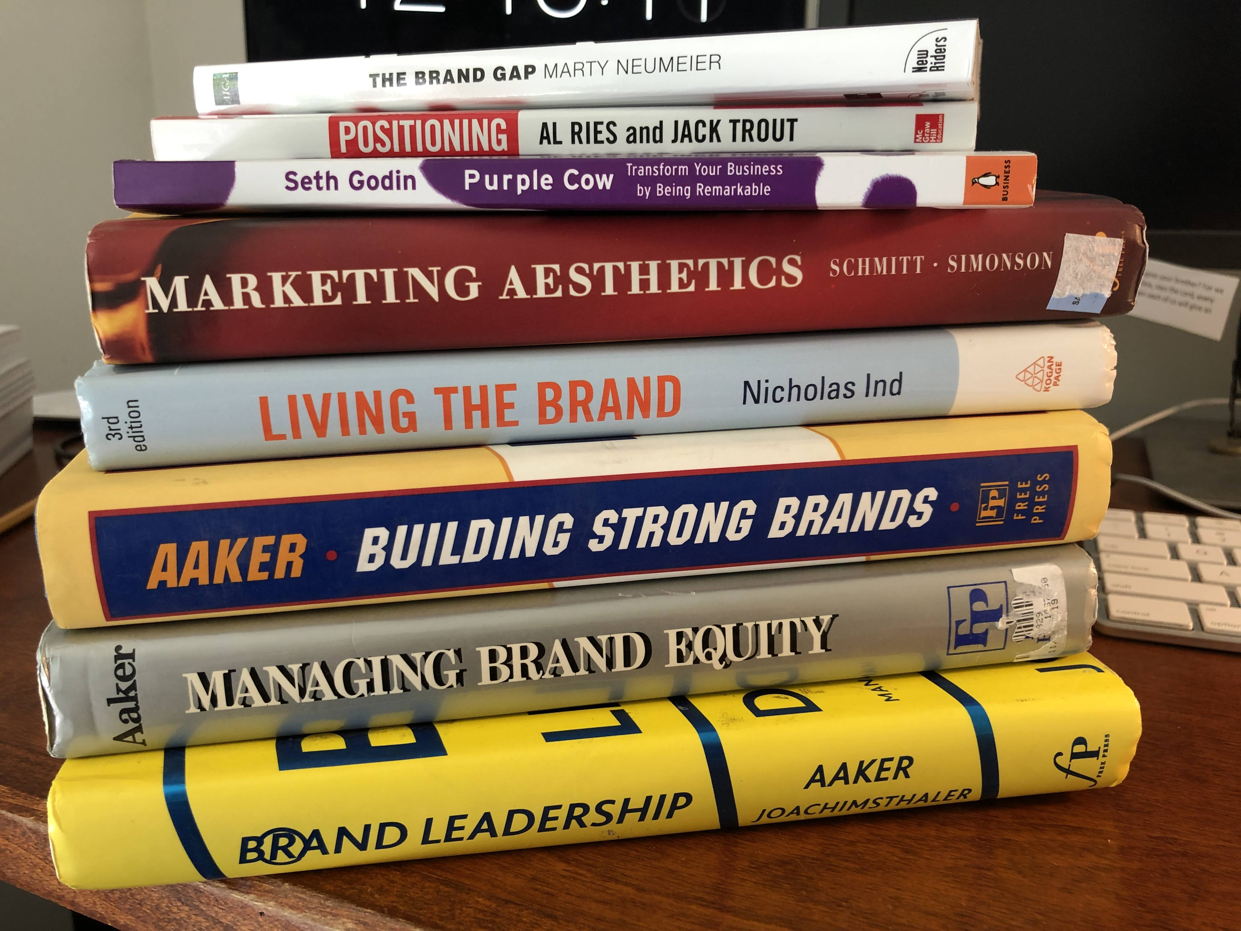
My Work-life Balance

Slide 3
Many different dimensions of life
Work
Spouse / Relationship
Children
Self Development / Education
Friends
Community
Religion
Fitness
Hobbies / Recreation
Vacation / Travel
Each with their own set of unique needs

Slide 4
Work-Life Balance Defined
Feeling like a “success” in all the important
spheres of your life.
My definition

Slide 5
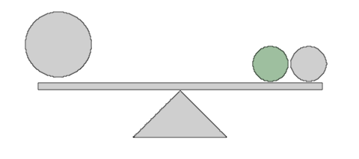
Understand your balance point
Don’t move the fulcrum

Slide 6
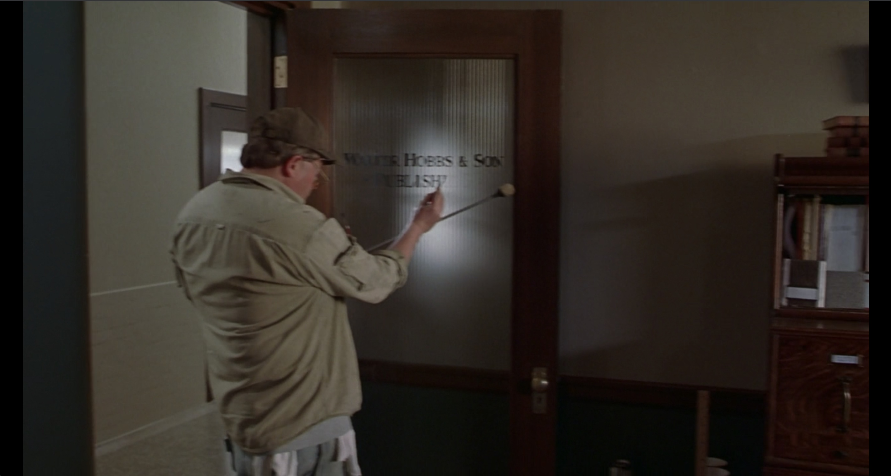

Slide 7
Work-life balance can be a false dichotomy
Work
Life
Combine and conquer

Slide 8
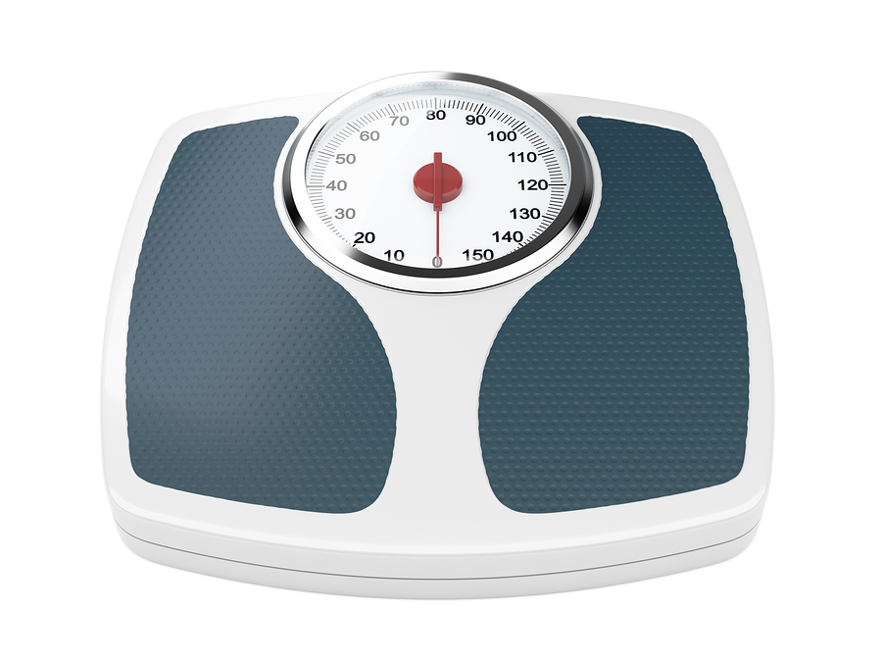
Build Feedback loops and indicators
Think
Do
Measure
How do I stay in balance?
This Photo by Unknown Author is licensed under CC BY-NC

Slide 9
Thank you
Any questions?

