Slide 1
Informed Delivery for Business Mailers
Michael Libby
Perinton Publishing
Rochester PCC
6/19/2019

Slide 2
Thanks to
We have used material presented at the 2019 NPF with the permission of the authors. They shared a lot of the same slides. At the end of this presentation is a link to their full presentations as well as other Informed Delivery Resources.
  Kurt Ruppel IWCO Direct-Director of Postal Policy and Marketing Communication
  Carrie Bornitz USPS-Informed Delivery Program Manager
  Robert E Dixon Jr USPS-Director of Product Technology Innovation

Slide 3
What we will cover today
A High Level Overview for Agencies and Marketing Firms
What is Informed Delivery
The business side of Informed Delivery drives what consumers see
Are consumers really using informed delivery?
Why make Informed Delivery part of Multi-Channel Marketing
Designing an Informed Delivery Campaign
Some results from Informed Delivery Pros
Review samples from my mailbox
What we won’t cover today
Manual Entry of data through the Mailer Campaign Portal on the Business Customer Gateway
Electronic Submission through PostalOne

Slide 4
A high level overview
Start an Informed Delivery Campaign before sending printed materials to the Mailing Service Provider
You need an integrated suite of
  Mailpieces
  Compelling collateral artwork for the consumers to replace the greyscale scans
  Web Links and Web Landing Page
  Measurement and Reporting

Slide 5
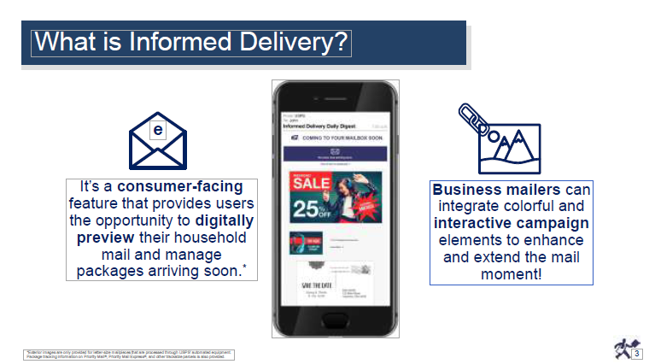

Slide 6
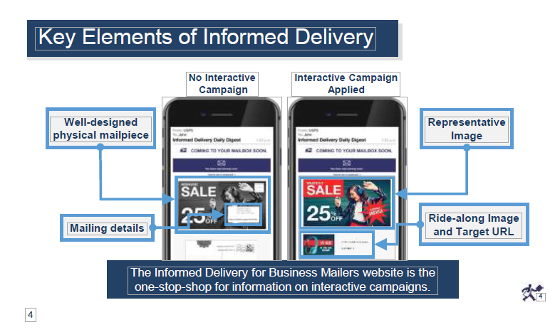

Slide 7
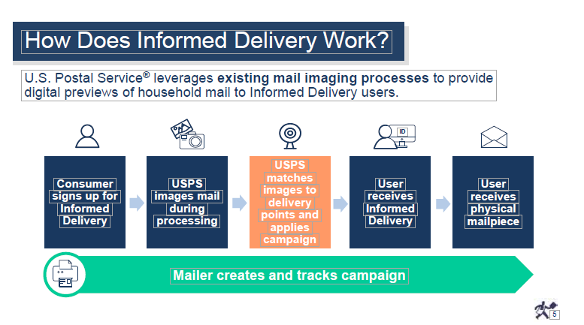

Slide 8
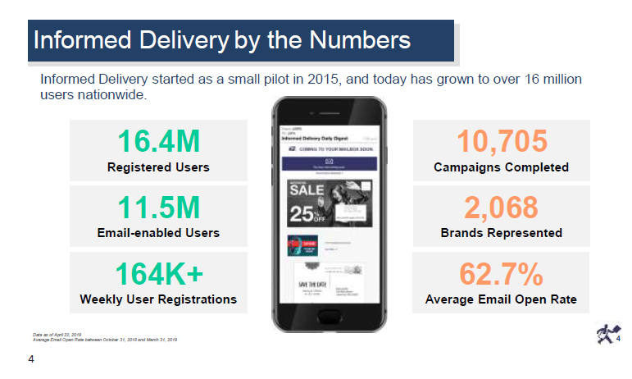
The USPS Projects up to 30 Million Users Nationwide by the next NPF

Slide 9
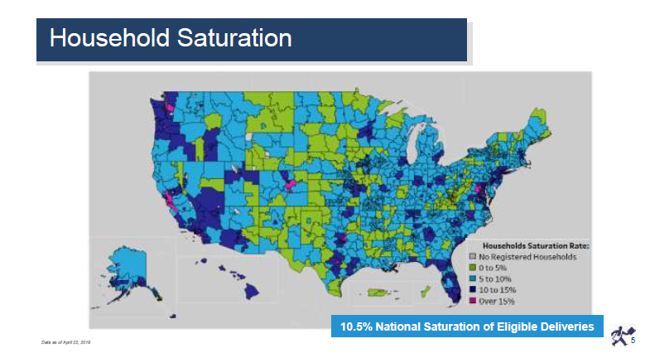

Slide 10
Why make informed delivery part of a multi-channel campaign
Multi-Channel Campaigns give you more opportunities to connect with your customer
Studies cited by the USPS claimed 37% lift with Multi-Channel Campaigns
Another result cited by the USPS cited a 50% lift in response rates and 25% more spending by consumers who signed up for Informed Delivery
I made a dinner reservation at Bonefish Grill before I read my mail at home
My wife regularly stops off at Joann Fabric and Craft Stores after seeing an ad in her email
How would your customers value you if you executed a multi-channel campaign with a 50% higher lift or 25% more spending by incorporating Informed Delivery

Slide 11
Steps in starting a campaign
Define your primary goal for the campaign
  Brand Impression to get people interested in seeing that mailpiece at home or
  Click through to a web landing page to drive a sale, ask for a sales contact, find the closest store
Find resources to develop web landing page and collateral artwork for the Consumer facing portal
Find a mailing service provider who can master the USPS Mailer Campaign Portal or PostalOne
  https://postalpro.usps.com/certifiedmsps
Monitor Progress and Results through the Mailer Campaign Portal

Slide 12
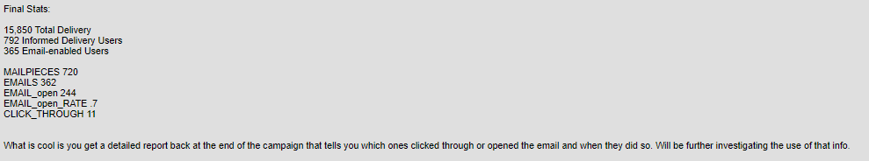
Some results from iD campaigns
From a mailer in Maryland 3/19/2018. 5% of the deliveries are registered with Informed Delivery

Slide 13
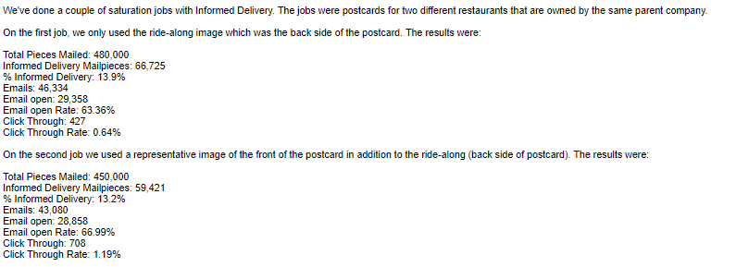
Some results from iD campaigns
From a mailer in Ohio 3/7/2019. Note that Informed Delivery registration has increased to 13.9% in 1 year

Slide 14
Review samples from my home mailbox
My 84 year old mother lives with my wife and I. Very little of this mail was addressed to me personally
Representative Image replaces the greyscale scan of the mailpiece and is optional on letter campaigns
Ride-Along images allow a reader to click through to a web landing page
If click throughs are the main objective then a Ride-Along only may make sense
For Brand Impressions, Representative Image might make more sense since it is larger
You will have to test to see what works for your mailing

Slide 15
questions?

Slide 16
resources
Visit this URL https://www.wisdmdirectmail.com/informed-delivery to get
  A copy of this Powerpoint Presentation
  A full copy of the 4 NPF 2019 Presentations I reference
  Copies of 2 of the studies cited by the USPS to support Informed Delivery ROI
  Guidelines on images used for a campaign
  Informed Campaign FAQs
  Mailer Campaign User Guide
  An Excel Spreadsheet showing ID participation down to the zip code level (hint: WNY is in the Eastern Area of the USPS)

